Slide 1
Introduction to Shell RANSINGH SATYAJIT RAY
The Unix command line has survived and thrived for almost 50 years because it lets people do complex things with just a few keystrokes. Sometimes called "the universal glue of programming," it helps users combine existing programs in new ways, automate repetitive tasks, and run programs on clusters and clouds that may be halfway around the world.

Slide 2
Manipulating files and directories
how to move around in the shell, and how to create, modify, and delete files and folders.
To find out where you are in the filesystem, run the command pwd (short for "print working directory"). This prints the absolute path of your current working directory, which is where the shell runs commands and looks for files by default.
$ pwd
/home/repl

Slide 3
How can I identify files and directories?
pwd tells you where you are. To find out what's there, type ls (which is short for "listing") and press the enter key. On its own, ls lists the contents of your current directory (the one displayed by pwd).
$ ls
backup bin course.txt people seasonal
$ ls /home/repl/seasonal
autumn.csv spring.csv summer.csv winter.csv

Slide 4
How else can I identify files and directories?
The shell decides if a path is absolute or relative by looking at its first character: If it begins with /, it is absolute. If it does not begin with /, it is relative.
You are in /home/repl. Use ls with a relative path to list the file that has an absolute path of /home/repl/course.txt (and only that file).
$ ls course.txt
course.txt

Slide 5
How can I move to another directory?
Just as you can move around in a file browser by double-clicking on folders, you can move around in the filesystem using the command cd (which stands for "change directory").
$ cd /home/repl/seasonal
Ransingh@LAPTOP-4AR568LC MINGW64 ~
$ cd d:
Ransingh@LAPTOP-4AR568LC MINGW64 /d
$ cd 'R Programming’ See the quotes
Ransingh@LAPTOP-4AR568LC MINGW64 /d/R Programming

Slide 6
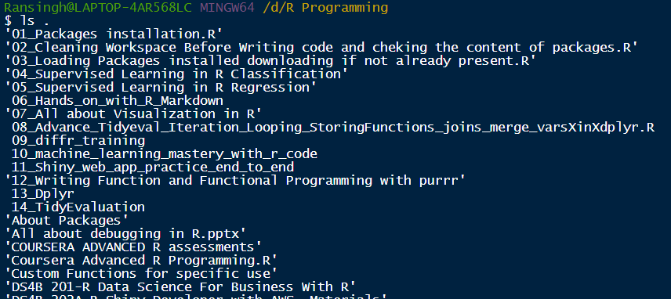
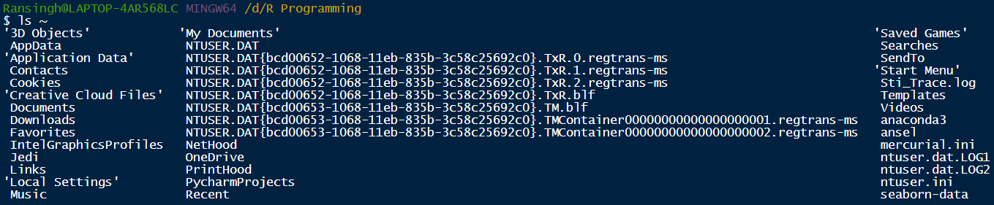
How can I move up a directory?
The parent of a directory is the directory above it. For example, /home is the parent of /home/repl, and /home/repl is the parent of /home/repl/seasonal.
More often, though, you will take advantage of the fact that the special path .. (two dots with no spaces) means "the directory above the one I'm currently in".
If you are in /home/repl/seasonal, then cd .. moves you up to /home/repl. If you use cd .. once again, it puts you in /home. One more cd .. puts you in the root directory /, which is the very top of the filesystem.
A single dot on its own, ., always means "the current directory", so ls on its own and ls . do the same thing, while cd . has no effect
One final special path is ~ (the tilde character), which means "your home directory", such as /home/repl. No matter where you are, ls ~ will always list the contents of your home directory, and cd ~ will always take you home.

Slide 7
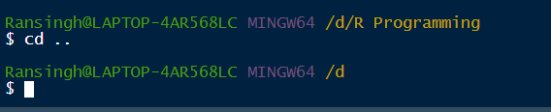
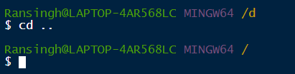
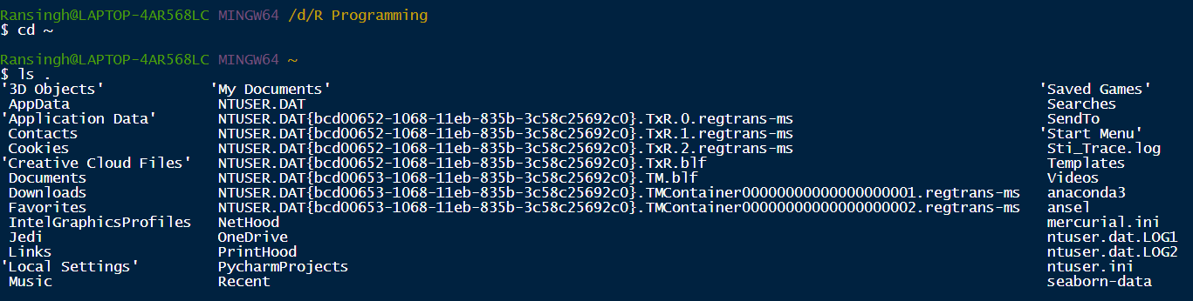

How can I move up a directory?
The equivalent is C:\Users\
So for you, your home directory would be here:
C:\Users\Ransingh

Slide 8
How can I copy files?
You will often want to copy files, move them into other directories to organize them, or rename them. One command to do this is cp, which is short for "copy". If original.txt is an existing file, then:
cp original.txt duplicate.txt
creates a copy of original.txt called duplicate.txt.
If there already was a file called duplicate.txt, it is overwritten. If the last parameter to cp is an existing directory, then a command like:
cp seasonal/autumn.csv seasonal/winter.csv backup
copies all of the files into that directory.
Make a copy of seasonal/summer.csv in the backup directory (which is also in /home/repl), calling the new file summer.bck.
$ cp seasonal/summer.csv backup/summer.bck
Copy spring.csv and summer.csv from the seasonal directory into the backup directory without changing your current working directory (/home/repl).
$ cp seasonal/spring.csv seasonal/summer.csv backup

Slide 9
How can I move a file?
While cp copies a file, mv moves it from one directory to another, just as if you had dragged it in a graphical file browser. It handles its parameters the same way as cp, so the command:
mv autumn.csv winter.csv ..
moves the files autumn.csv and winter.csv from the current working directory up one level to its parent directory (because .. always refers to the directory above your current location).
You are in /home/repl, which has sub-directories seasonal and backup. Using a single command, move spring.csv and summer.csv from seasonal to backup.
$ mv seasonal/spring.csv seasonal/summer.csv backup

Slide 10
How can I rename files?
mv can also be used to rename files. If you run:
mv course.txt old-course.txt
then the file course.txt in the current working directory is "moved" to the file old-course.txt.
mv winter.csv winter.csv.bck

Slide 11
How can I delete files?
We can copy files and move them around; to delete them, we use rm, which stands for "remove". As with cp and mv, you can give rm the names of as many files as you'd like, so:
rm thesis.txt backup/thesis-2017-08.txt
removes both thesis.txt and backup/thesis-2017-08.txt
rm does exactly what its name says, and it does it right away: unlike graphical file browsers, the shell doesn't have a trash can, so when you type the command above, your thesis is gone for good.

Slide 12
How can I create and delete directories?
mv treats directories the same way it treats files: if you are in your home directory and run mv seasonal by-season, for example, mv changes the name of the seasonal directory to by-season. However, rm works differently.
If you try to rm a directory, the shell prints an error message telling you it can't do that, primarily to stop you from accidentally deleting an entire directory full of work. Instead, you can use a separate command called rmdir.
For added safety, it only works when the directory is empty, so you must delete the files in a directory before you delete the directory.
Without changing directories, delete the file agarwal.txt in the people directory.
$ rm people/agarwal.txt
Now that the people directory is empty, use a single command to delete it.
$ rmdir people

Slide 13
How can I view a file's contents?
The simplest way to do this is with cat, which just prints the contents of files onto the screen.
cat agarwal.txt
name: Agarwal, Jasmine
position: RCT2
start: 2017-04-01
Benefits: full

Slide 14
How can I view a file's contents piece by piece?
You can use cat to print large files and then scroll through the output, but it is usually more convenient to page the output.
The original command for doing this was called more, but it has been superseded by a more powerful command called less.
When you less a file, one page is displayed at a time; you can press spacebar to page down or type q to quit.
If you give less the names of several files, you can type :n (colon and a lower-case 'n') to move to the next file, :p to go back to the previous one, or :q to quit.

Slide 15
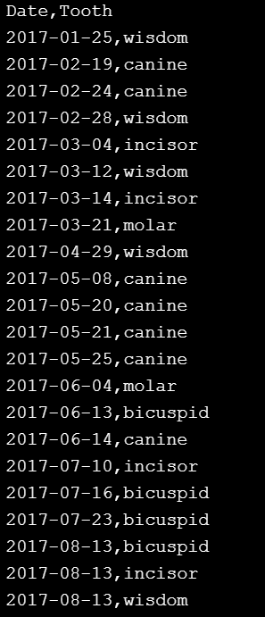
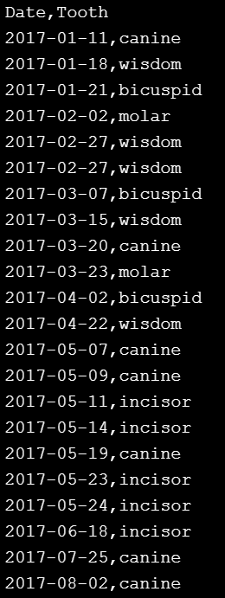
How can I view a file's contents piece by piece?
:q

Slide 16
How can I look at the start of a file?
We can do this in the shell using a command called head. As its name suggests, it prints the first few lines of a file (where "a few" means 10), so the command:
head seasonal/summer.csv
displays:
Date,Tooth
2017-01-11,canine
2017-01-18,wisdom
2017-01-21,bicuspid
2017-02-02,molar
2017-02-27,wisdom
2017-02-27,wisdom
2017-03-07,bicuspid
2017-03-15,wisdom
2017-03-20,canine

Slide 17
How can I type less?
One of the shell's power tools is tab completion. If you start typing the name of a file and then press the tab key, the shell will do its best to auto-complete the path. For example, if you type sea and press tab, it will fill in the directory name seasonal/ (with a trailing slash). If you then type a and tab, it will complete the path as seasonal/autumn.csv.

Slide 18
How can I control what commands do?
You won't always want to look at the first 10 lines of a file, so the shell lets you change head's behavior by giving it a command-line flag (or just "flag" for short). If you run the command:
head -n 3 seasonal/summer.csv
head will only display the first three lines of the file. If you run head -n 100, it will display the first 100 (assuming there are that many), and so on.

Slide 19
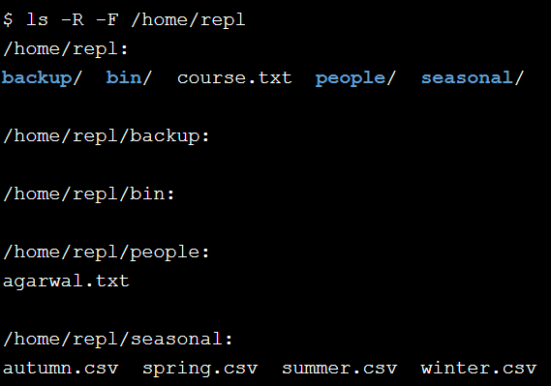
How can I list everything below a directory?
In order to see everything underneath a directory, no matter how deeply nested it is, you can give ls the flag -R (which means "recursive"). If you use ls -R in your home directory, you will see something like this:
To help you know what is what, ls has another flag -F that prints a / after the name of every directory and a * after the name of every runnable program. Run ls with the two flags, -R and -F, and the absolute path to your home directory to see everything it contains.

Slide 20
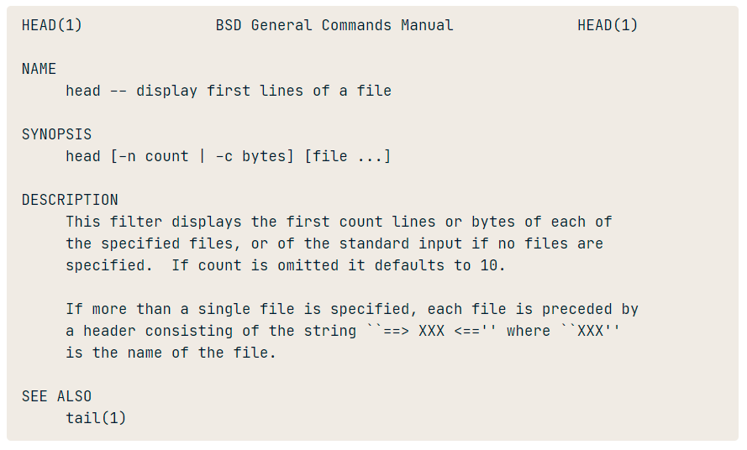
How can I get help for a command?
To find out what commands do, people used to use the man command (short for "manual").
For example, the command man head brings up this information:

Slide 21
How can I select columns from a file?
head and tail let you select rows from a text file. If you want to select columns, you can use the command cut. It has several options (use man cut to explore them), but the most common is something like:
cut -f 2-5,8 -d , values.csv
which means "select columns 2 through 5 and columns 8, using comma as the separator". cut uses -f (meaning "fields") to specify columns and -d (meaning "delimiter") to specify the separator. You need to specify the latter because some files may use spaces, tabs, or colons to separate columns.
cut is a simple-minded command. In particular, it doesn't understand quoted strings. If, for example, your file is:
Name,Age
"Johel,Ranjit",28
"Sharma,Rupinder",26
then:
cut -f 2 -d , everyone.csv
will produce:
Age
Ranjit"
Rupinder"

Slide 22
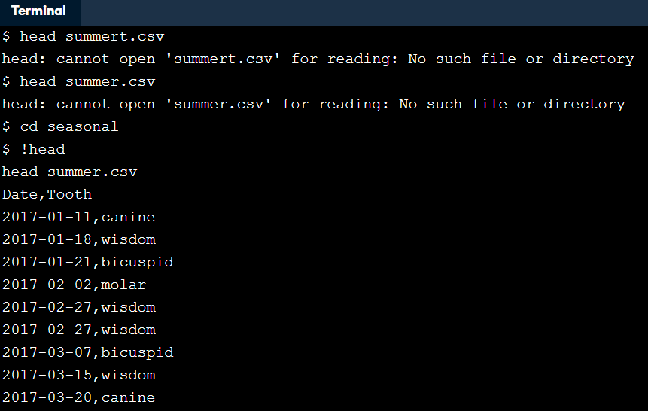
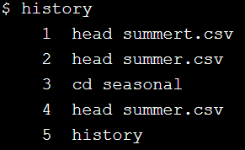
How can I repeat commands?
You can also re-run a command by typing an exclamation mark followed by the command's name, such as !head or !cut, which will re-run the most recent use of that command.

Slide 23
How can I select lines containing specific values?
head and tail select rows, cut selects columns, and grep selects lines according to what they contain.
In its simplest form, grep takes a piece of text followed by one or more filenames and prints all of the lines in those files that contain that text.
What's more important right now is some of grep's more common flags:
-c: print a count of matching lines rather than the lines themselves
-h: do not print the names of files when searching multiple files
-i: ignore case (e.g., treat "Regression" and "regression" as matches)
-l: print the names of files that contain matches, not the matches
-n: print line numbers for matching lines
-v: invert the match, i.e., only show lines that don't match

Slide 24

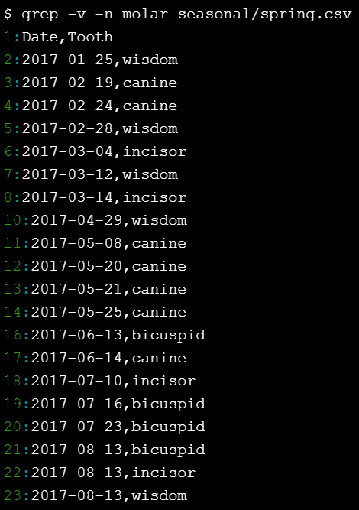
How can I select lines containing specific values?
Print the contents of all of the lines containing the word molar in seasonal/autumn.csv by running a single command while in your home directory. Don't use any flags.
Invert the match to find all of the lines that don't contain the word molar in seasonal/spring.csv, and show their line numbers. Remember, it's considered good style to put all of the flags before other values like filenames or the search term "molar".

Slide 25

How can I select lines containing specific values?
Count how many lines contain the word incisor in autumn.csv and winter.csv combined. (Again, run a single command from your home directory.)

Slide 26
How can I store a command's output in a file?
If you run this command :
head -n 5 seasonal/summer.csv > top.csv
nothing appears on the screen. Instead, head's output is put in a new file called top.csv.
he greater-than sign > tells the shell to redirect head's output to a file. It isn't part of the head command; instead, it works with every shell command that produces output.

Slide 27
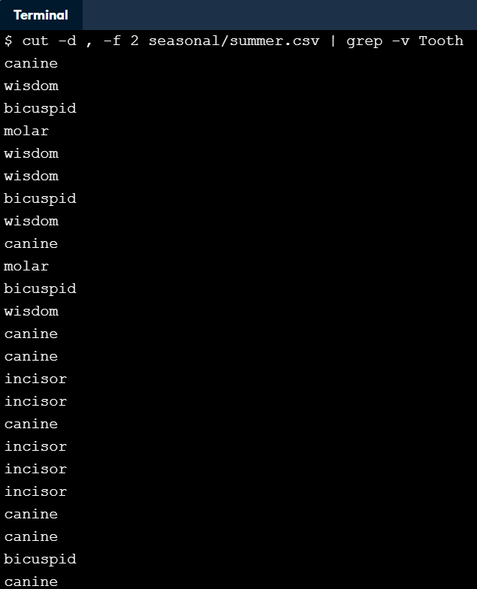
What's a better way to combine commands?
Using redirection to combine commands has two drawbacks:
It leaves a lot of intermediate files lying around (like top.csv).
The commands to produce your final result are scattered across several lines of history.
The shell provides another tool that solves both of these problems at once called a pipe.
head -n 5 seasonal/summer.csv | tail -n 3
The pipe symbol tells the shell to use the output of the command on the left as the input to the command on the right.

Slide 28

How can I count the records in a file?
The command wc (short for "word count") prints the number of characters, words, and lines in a file. You can make it print only one of these using -c, -w, or -l respectively.

Slide 29
How can I specify many files at once?
To make your life better, the shell allows you to use wildcards to specify a list of files with a single expression. The most common wildcard is *, which means "match zero or more characters".
Most shell commands will work on multiple files if you give them multiple filenames. For example, you can get the first column from all of the seasonal data files at once like this:
cut -d , -f 1 seasonal/winter.csv seasonal/spring.csv seasonal/summer.csv seasonal/

Slide 30
How can I specify many files at once?
cut -d , -f 1 seasonal/*.csv
To make your life better, the shell allows you to use wildcards to specify a list of files with a single expression. The most common wildcard is *, which means "match zero or more characters".
cut -d , -f 1 seasonal/*
Or
cut -d , -f 1 seasonal/*.csv
Write a single command using head to get the first three lines from both seasonal/spring.csv and seasonal/summer.csv, a total of six lines of data, but not from the autumn or winter data files. Use a wildcard instead of spelling out the files' names in full.

Slide 31
What other wildcards can I use?
The shell has other wildcards as well, though they are less commonly used:
? matches a single character, so 201?.txt will match 2017.txt or 2018.txt, but not 2017-01.txt.
[...] matches any one of the characters inside the square brackets, so 201[78].txt matches 2017.txt or 2018.txt, but not 2016.txt.
{...} matches any of the comma-separated patterns inside the curly brackets, so {*.txt, *.csv} matches any file whose name ends with .txt or .csv, but not files whose names end with .pdf.

Slide 32
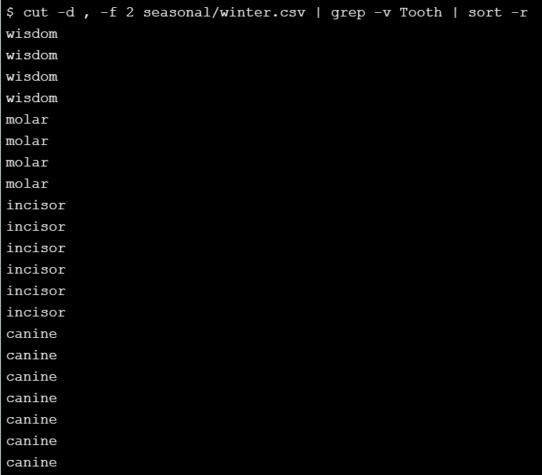
How can I sort lines of text?
As its name suggests, sort puts data in order. By default it does this in ascending alphabetical order, but the flags -n and -r can be used to sort numerically and reverse the order of its output, while -b tells it to ignore leading blanks and -f tells it to fold case (i.e., be case-insensitive). Pipelines often use grep to get rid of unwanted records and then sort to put the remaining records in order.
Remember the combination of cut and grep to select all the tooth names from column 2 of seasonal/summer.csv?
cut -d , -f 2 seasonal/summer.csv | grep -v Tooth
Starting from this recipe, sort the names of the teeth in seasonal/winter.csv (not summer.csv) in descending alphabetical order. To do this, extend the pipeline with a sort step.

Slide 33
How can I remove duplicate lines?
Another command that is often used with sort is uniq, whose job is to remove duplicated lines. More specifically, it removes adjacent duplicated lines. If a file contains:
2017-07-03
2017-07-03
2017-08-03
2017-08-03
then uniq will produce:
2017-07-03
2017-08-03

Slide 34
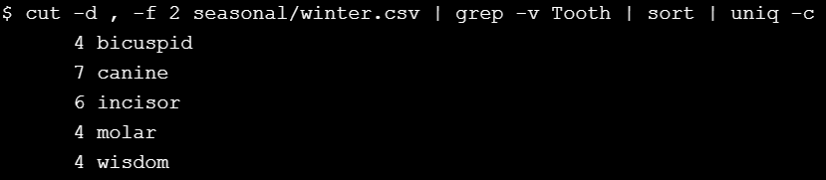
How can I remove duplicate lines?
but if it contains:
2017-07-03
2017-08-03
2017-07-03
2017-08-03
then uniq will print all four lines. The reason is that uniq is built to work with very large files. In order to remove non-adjacent lines from a file, it would have to keep the whole file in memory (or at least, all the unique lines seen so far). By only removing adjacent duplicates, it only has to keep the most recent unique line in memory.

Slide 35
How can I save the output of a pipe?
The shell lets us redirect the output of a sequence of piped commands:
cut -d , -f 2 seasonal/*.csv | grep -v Tooth > teeth-only.txt
However, > must appear at the end of the pipeline: if we try to use it in the middle, like this:
cut -d , -f 2 seasonal/*.csv > teeth-only.txt | grep -v Tooth
then all of the output from cut is written to teeth-only.txt, so there is nothing left for grep and it waits forever for some input.

Slide 36
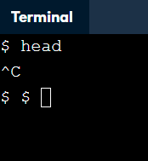
How can I stop a running program?
You may also mistakenly put redirection in the middle of a pipeline, causing it to hang up. If you decide that you don't want a program to keep running, you can type Ctrl + C to end it.

Slide 37
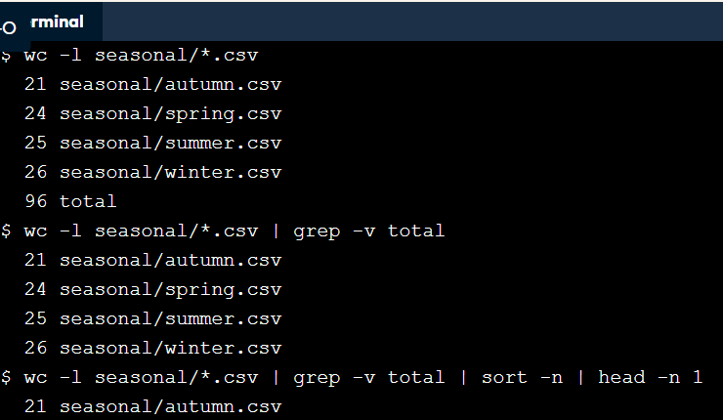
Use wc with appropriate parameters to list the number of lines in all of the seasonal data files. (Use a wildcard for the filenames instead of typing them all in by hand.)
Add another command to the previous one using a pipe to remove the line containing the word "total".
Add two more stages to the pipeline that use sort -n and head -n 1 to find the file containing the fewest lines.

Slide 38
Batch Processing How does the shell store information?
Like other programs, the shell stores information in variables. Some of these, called environment variables, are available all the time. Environment variables' names are conventionally written in upper case, and a few of the more commonly-used ones are shown below.
To get a complete list (which is quite long), you can type set in the shell.
Variable | Purpose | Value
HOME | User's home directory | /home/repl
PWD | Present working directory | Same as pwd command
SHELL | Which shell program is being used | /bin/bash
USER | User's ID | repl
the shell saves 2000 old commands by default on this system.

Slide 39
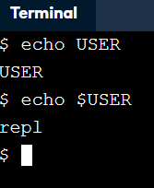

How can I print a variable's value?
A simpler way to find a variable's value is to use a command called echo, which prints its arguments. Typing
echo hello DataCamp!
prints
hello DataCamp!
If you try to use it to print a variable's value like this:
echo USER
it will print the variable's name, USER.
To get the variable's value, you must put a dollar sign $ in front of it. Typing
echo $USER
prints
repl

Slide 40
How else does the shell store information?
The other kind of variable is called a shell variable, which is like a local variable in a programming language.
To create a shell variable, you simply assign a value to a name:
training=seasonal/summer.csv
without any spaces before or after the = sign. Once you have done this, you can check the variable's value with:
echo $training
seasonal/summer.csv

Slide 41
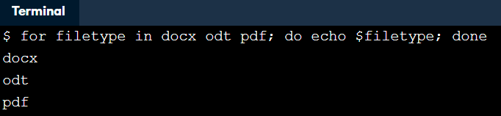
How can I repeat a command many times?
Shell variables are also used in loops, which repeat commands many times. If we run this command:
for filetype in gif jpg png; do echo $filetype; done
it produces:
gif
jpg
Png
Notice these things about the loop:
The structure is for …variable… in …list… ; do …body… ; done
The list of things the loop is to process (in our case, the words gif, jpg, and png).
The variable that keeps track of which thing the loop is currently processing (in our case, filetype).
The body of the loop that does the processing (in our case, echo $filetype).

Slide 42
How can I repeat a command once for each file?
You can always type in the names of the files you want to process when writing the loop, but it's usually better to use wildcards. Try running this loop in the console:
for filename in seasonal/*.csv; do echo $filename; done
It prints:
seasonal/autumn.csv
seasonal/spring.csv
seasonal/summer.csv
seasonal/winter.csv
because the shell expands seasonal/*.csv to be a list of four filenames before it runs the loop.

Slide 43
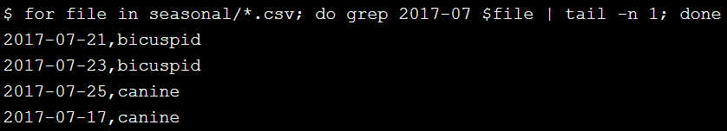
How can I run many commands in a single loop?
Write a loop that prints the last entry from July 2017 (2017-07) in every seasonal file. It should produce a similar output to:
grep 2017-07 seasonal/winter.csv | tail -n 1
but for each seasonal file separately. Please use file as the name of the loop variable, and remember to loop through the list of files seasonal/*.csv (instead of 'seasonal/winter.csv' as in the example).
for file in seasonal/*.csv; do grep 2017-07 $file | tail -n 1; done

Slide 44
Why shouldn't I use spaces in filenames?
It's easy and sensible to give files multi-word names like July 2017.csv when you are using a graphical file explorer. However, this causes problems when you are working in the shell. For example, suppose you wanted to rename July 2017.csv to be 2017 July data.csv. You cannot type:
mv July 2017.csv 2017 July data.csv
because it looks to the shell as though you are trying to move four files called July, 2017.csv, 2017, and July (again) into a directory called data.csv. Instead, you have to quote the files' names so that the shell treats each one as a single parameter:
mv 'July 2017.csv' '2017 July data.csv'

Slide 45
How can I do many things in a single loop?
The loops you have seen so far all have a single command or pipeline in their body, but a loop can contain any number of commands. To tell the shell where one ends and the next begins, you must separate them with semi-colons:
for f in seasonal/*.csv; do echo $f; head -n 2 $f | tail -n 1; done
seasonal/autumn.csv
2017-01-05,canine
seasonal/spring.csv
2017-01-25,wisdom
seasonal/summer.csv
2017-01-11,canine
seasonal/winter.csv
2017-01-03,bicuspid

Slide 46
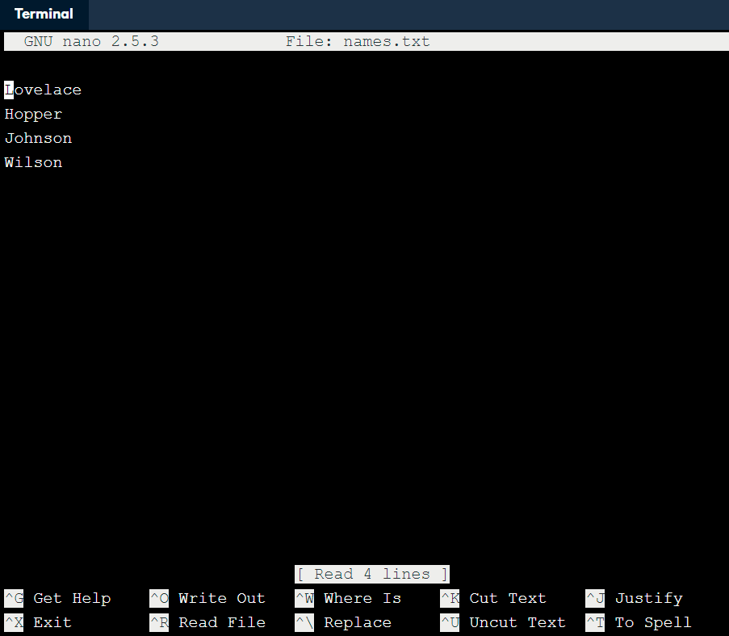
How can I edit a file?
You can move around with the arrow keys, delete characters using backspace, and do other operations with control-key combinations:
Ctrl + K: delete a line.
Ctrl + U: un-delete a line.
Ctrl + O: save the file ('O' stands for 'output'). You will also need to press Enter to confirm the filename!
Ctrl + X: exit the editor.

Slide 47
How can I save commands to re-run later?
You have been using the shell interactively so far. But since the commands you type in are just text, you can store them in files for the shell to run over and over again. To start exploring this powerful capability, put the following command in a file called headers.sh:
head -n 1 seasonal/*.csv
This command selects the first row from each of the CSV files in the seasonal directory. Once you have created this file, you can run it by typing:
bash headers.sh
This tells the shell (which is just a program called bash) to run the commands contained in the file headers.sh, which produces the same output as running the commands directly.

Slide 48

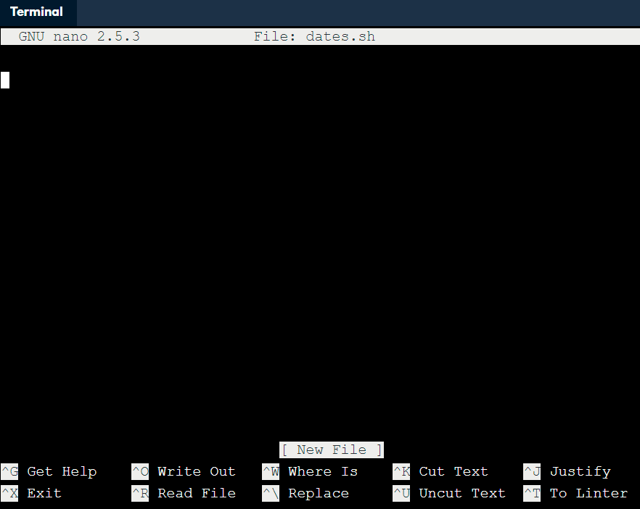
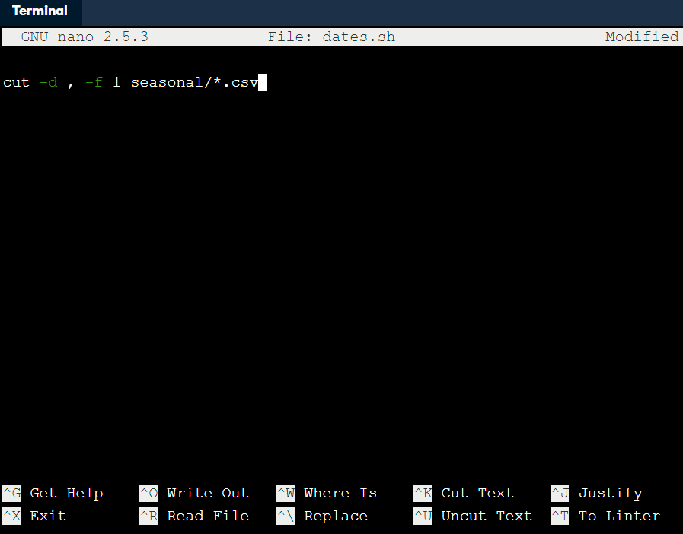
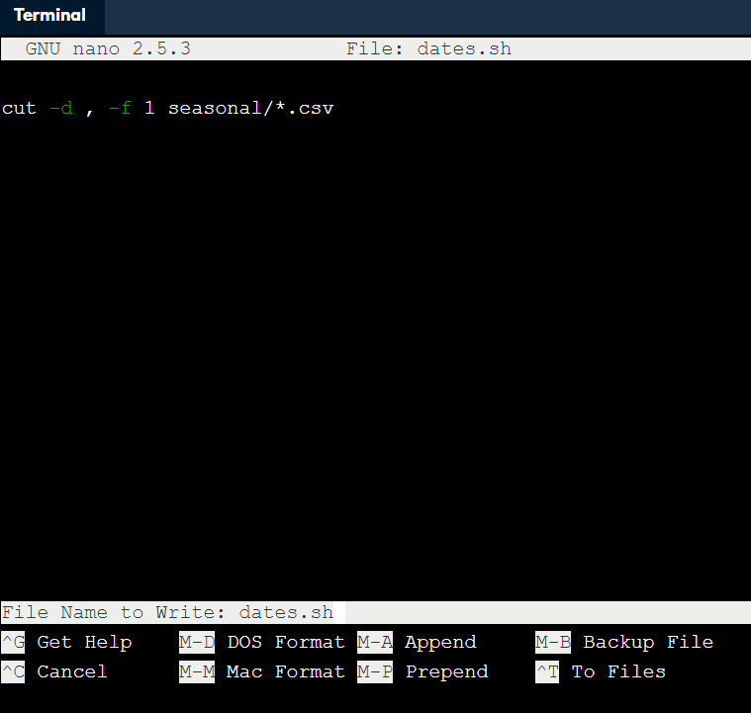
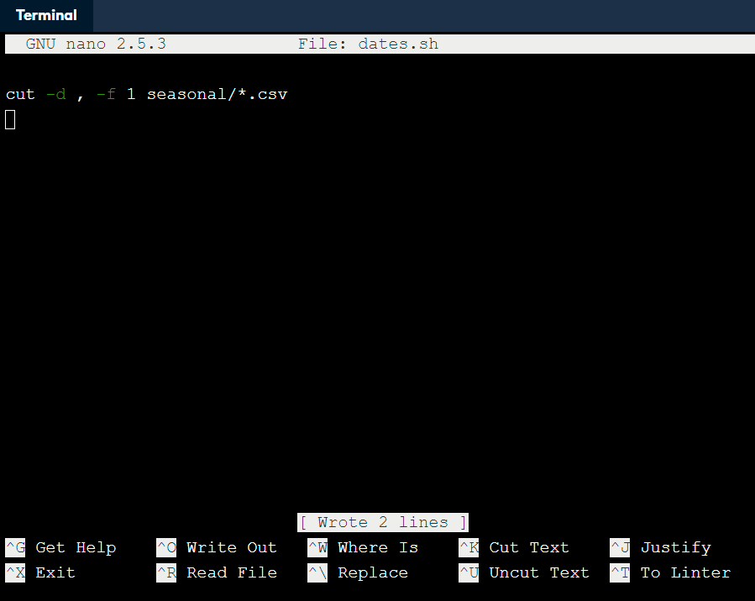

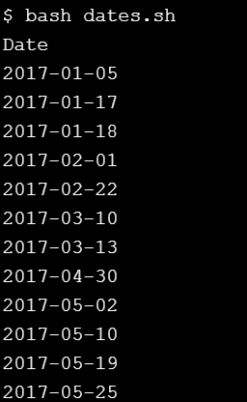
How can I save commands to re-run later?
Ctrl + O
Enter
Ctrl + X

Slide 49
How can I re-use pipes?
A file full of shell commands is called a *shell script, or sometimes just a "script" for short. Scripts don't have to have names ending in .sh, but this lesson will use that convention to help you keep track of which files are scripts.
Scripts can also contain pipes. For example, if all-dates.sh contains this line:
cut -d , -f 1 seasonal/*.csv | grep -v Date | sort | uniq
then:
bash all-dates.sh > dates.out
will extract the unique dates from the seasonal data files and save them in dates.out.

Slide 50

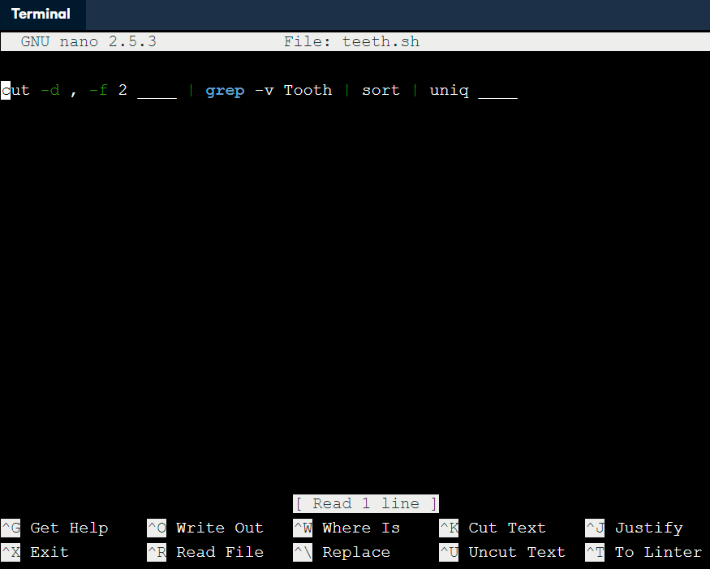
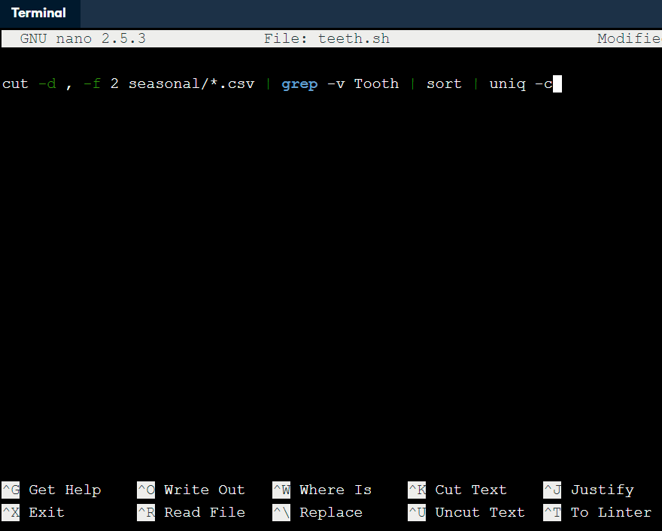


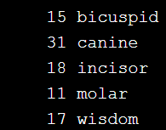
How can I re-use pipes?
Ctrl + O
Ctrl + X

Slide 51
How can I pass filenames to scripts?
A script that processes specific files is useful as a record of what you did, but one that allows you to process any files you want is more useful. To support this, you can use the special expression $@ (dollar sign immediately followed by at-sign) to mean "all of the command-line parameters given to the script".
For example, if unique-lines.sh contains sort $@ | uniq, when you run:
bash unique-lines.sh seasonal/summer.csv
the shell replaces $@ with seasonal/summer.csv and processes one file. If you run this:
bash unique-lines.sh seasonal/summer.csv seasonal/autumn.csv
it processes two data files, and so on.
As a reminder, to save what you have written in Nano, type Ctrl + O to write the file out, then Enter to confirm the filename, then Ctrl + X to exit the editor.

Slide 52

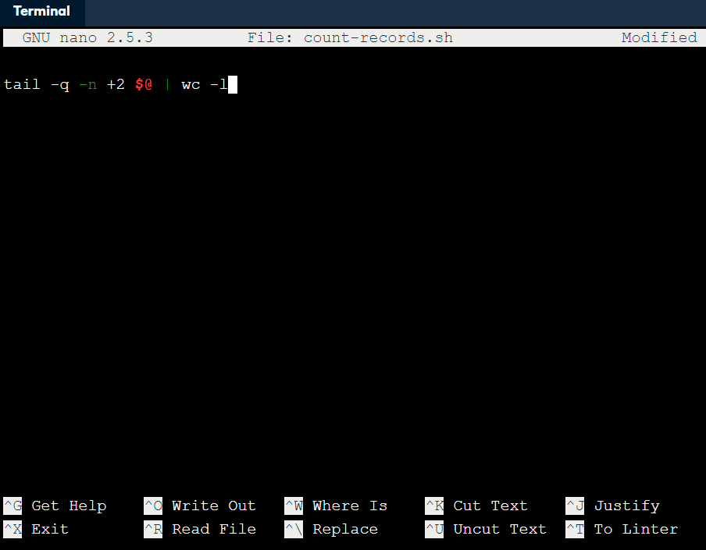


How can I pass filenames to scripts?

